Slide 1
Machine Learning
Machine Learning Introduction to Machine Learning by Kumar Anurupam is licensed under a Creative Commons Attribution-4.0 International License.
Model Evaluation Measures – Part I
CS 3104 Fall 2019
Lecture Slides by Kumar Anurupam

Slide 2
Learning Objectives
After the completion of today’s lesson students will be able to:
Learn the importance of evaluation measures for the various problems.
Discuss the performance measures of classification problem and regression problems.

Slide 3
Agenda
Introduction
ROC Curve
Confusion matrix
Cost matrix
Cost measures
Error measures

Slide 4
Introduction
Evaluating the performance of a Machine Learning Model is very important task.
Various evaluation methods are used to examine the efficiency, performance and quality of any model.
Some criteria like accuracy, cost, computational complexity etc. can be used to select the appropriate model among many.
For different techniques different methods are useful.

Slide 5
Performance measure method for classification problem
Some of the most commonly used methods are:
ROC Curve
Confusion Matrix
Cost Matrix

Slide 6
Agenda
Introduction
ROC Curve
Confusion matrix
Cost matrix
Cost measures
Error measures

Slide 7
ROC (Receiver Operating Characteristic)^{[1]}
A receiver operating characteristic curve, i.e., ROC curve, is a graphical plot that illustrates the diagnostic ability of a binary classifier system as its discrimination threshold is varied.
The ROC curve is created by plotting the true positive rate (TPR) against the false positive rate (FPR) at various threshold settings.
The true-positive rate is also known as sensitivity, recall or probability of detection in machine learning.
The false-positive rate is also known as the fall-out or probability of false alarm and can be calculated as (1 − specificity).

Slide 8
ROC (Receiver Operating Characteristic)
Developed in 1950s for signal detection theory to analyze noisy signals
Characterize the trade-off between positive hits and false alarms
ROC curve plots TPR (on the y-axis) against FPR (on the x-axis)
 | PREDICTED CLASS
Actual |  | Yes | No
 | Yes | a (TP) | b (FN)
 | No | c (FP) | d (TN)
Fraction of positive instances predicted correctly
Fraction of negative instances predicted incorrectly

Slide 9
ROC (Receiver Operating Characteristic)
Performance of a classifier represented as a point on the ROC curve
Changing some parameter of the algorithm, sample distribution or cost matrix changes the location of the point

Slide 10
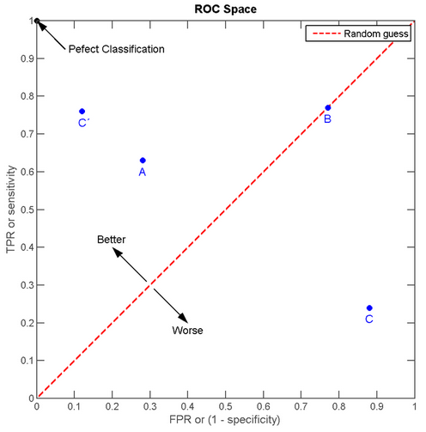
ROC Curve regions

Slide 11
ROC Curve
E.g.

Slide 12
Agenda
Introduction
ROC Curve
Confusion matrix
Cost matrix
Cost measures
Error measures

Slide 13
Confusion Matrix
Focus on the predictive capability of a model
Rather than how fast it takes to classify or build models, scalability, etc.
Confusion Matrix:
 | PREDICTED CLASS
ACTUAL CLASS |  | Class=Yes | Class=No
 | Class=Yes | a | b
 | Class=No | c | d
a: TP (true positive)
b: FN (false negative)
c: FP (false positive)
d: TN (true negative)

Slide 14
Confusion Matrix…
 | PREDICTED CLASS
ACTUAL CLASS |  | Class=Yes | Class=No
 | Class=Yes | a (TP) | b (FN)
 | Class=No | c (FP) | d (TN)
Most widely-used metric:

Slide 15
Confusion Matrix - Limitation of Accuracy
Consider a 2-class problem
Number of Class 0 examples = 9990
Number of Class 1 examples = 10
If model predicts everything to be class 0, accuracy is 9990/10000 = 99.9 %
Accuracy is misleading because model does not detect any class 1 example

Slide 16
Agenda
Introduction
ROC Curve
Confusion matrix
Cost matrix
Cost measures
Error measures

Slide 17
Cost Matrix
 | PREDICTED CLASS
ACTUAL CLASS | C(i|j) | Class=Yes | Class=No
 | Class=Yes | C(Yes|Yes) | C(No|Yes)
 | Class=No | C(Yes|No) | C(No|No)
C(i|j): Cost of classifying class j example as class i

Slide 18
Cost Matrix - Computing Cost of Classification
Cost Matrix | PREDICTED CLASS
ACTUAL CLASS | C(i|j) | + | -
 | + | -1 | 100
 | - | 1 | 0
Model M₁ | PREDICTED CLASS
ACTUAL CLASS |  | + | -
 | + | 150 | 40
 | - | 60 | 250
Model M₂ | PREDICTED CLASS
ACTUAL CLASS |  | + | -
 | + | 250 | 45
 | - | 5 | 200
Accuracy = 80%
Cost = 3910
Accuracy = 90%
Cost = 4255

Slide 19
Agenda
Introduction
ROC Curve
Confusion matrix
Cost matrix
Cost measures
Error measures

Slide 20



Cost Sensitive measures ^{[3]}
Precision(p)/Positive Predictive Value(PPV):
exactness – what % of tuples that the classifier labeled as positive are actually positive
False Discovery Rate:
Recall(r)/Sensitivity/True Positive Rate(TPR):
completeness – what % of positive tuples did the classifier label as positive?
Perfect score is 1.0. Inverse relationship between precision & recall
Where, P = Number of real positive cases in data

Slide 21




Cost Sensitive measures
Specificity, Selectivity or True Negative Rate (TNR):
False Positive Rate/Fallout:
False Negative Rate/Miss Rate:
F1-Score:

Slide 22
Agenda
Introduction
ROC Curve
Confusion matrix
Cost matrix
Cost measures
Error measures

Slide 23
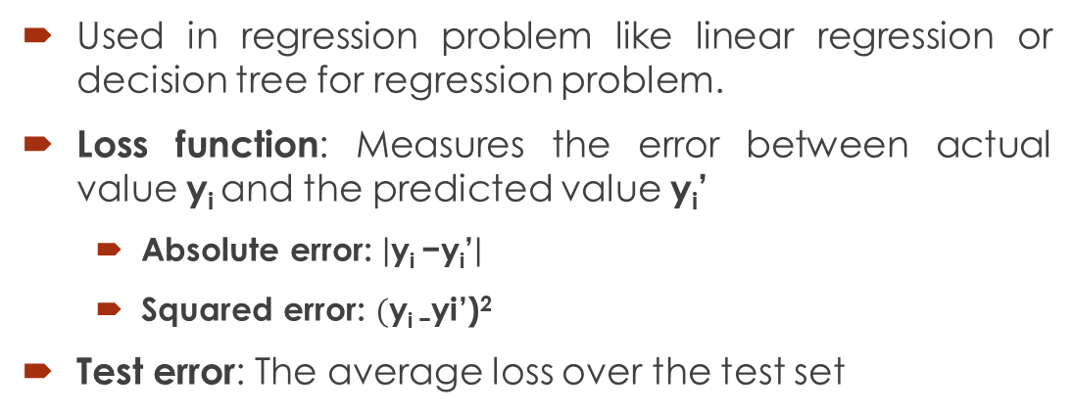
Predictor Error Measures
Used in regression problem like linear regression or decision tree for regression problem.
Loss function: Measures the error between actual value y_{i} and the predicted value y_{i}’
Absolute error: $\left|\text{y}\text{i}\text{ −}\text{yi}\text{’}\right|$
Squared error: $(\text{y}\text{i}\text{ −}\text{yi}$’)²
Test error: The average loss over the test set
Mean absolute error
Mean squared error
Relative absolute error
Relative squared error

Slide 24
Summary
Evaluating the performance of the models are very important to select the models for a task.
Classification problems can be analyzed easily with the help of ROC curve, Confusion matrix, Cost matrix etc.
Precision, recall, sensitivity, specificity are a few measures of cost
Error can be evaluated by Mean absolute error, Mean squared error, Relative absolute error and Relative squared error.

Slide 25
References
[1]https://en.wikipedia.org/wiki/Receiver_operating_characteristic
[2]https://www.cs.cmu.edu/~schneide/tut5/node42.html
[3] https://en.wikipedia.org/wiki/Precision_and_recall

Slide 26
Thanks

